Slide 1
College Admission Agent (RAG-based)
IBM HACKATHON PROJECT
Presented By:
Student name : Harsh Ranjan
College Name & Department : Chandigarh University, BE-Computer Science & Engineering

Slide 2
OUTLINE
Problem Statement
Technology used
Wow factor
End users
Result
Conclusion
Git-hub Link
Future scope
IBM Certifications

Slide 3
Problem Statement
The college admission process is often filled with repetitive queries from prospective students about eligibility criteria, available courses, fee structures, and important deadlines. These inquiries are typically handled through phone calls, emails, or in-person visits, which demand significant administrative effort and can lead to delays in responses, resulting in a frustrating and inefficient experience for applicants.
Proposed Solution: The proposed system provides instant and accurate admission-related responses using RAG and AI-powered conversation. It retrieves details like eligibility, fees, courses, and deadlines, processes queries through a RAG-based agent with IBM Granite, and delivers concise answers via a web or chatbot interface on IBM Cloud Lite. The system is tested with sample queries for accuracy, speed, and reliability.

Slide 4
Technology used
IBM cloud lite services
Natural Language Processing (NLP)
Retrieval Augmented Generation (RAG)
IBM Granite model

Slide 5
IBM cloud services used
IBM Cloud Watsonx AI Studio
IBM Cloud Watsonx AI runtime
IBM Cloud Agent Lab
IBM Granite foundation model

Slide 6
Wow factors
Instant Query Resolution – Provides answers to admission-related questions in seconds, reducing manual effort.
AI-Powered Conversational Experience – Uses RAG with IBM Granite to deliver human-like, context-aware responses.
Customizable Knowledge Base – Admission staff can update data easily without modifying the core system.
Time & Effort Saver – Reduces repetitive queries for admission offices, improving operational efficiency.

Slide 7
End users
Academic Researchers
Research Institutions and Universities
Industry R&D Teams
Educators
Students

Slide 8
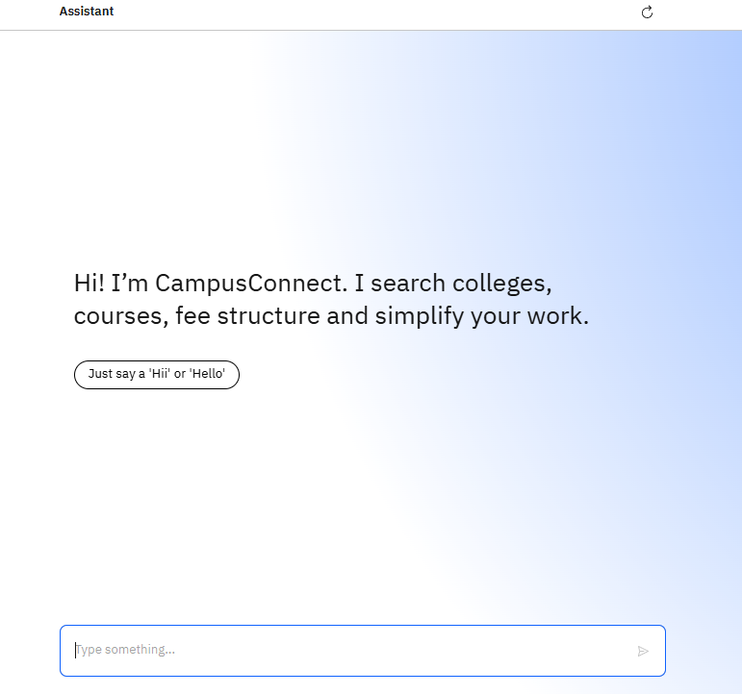
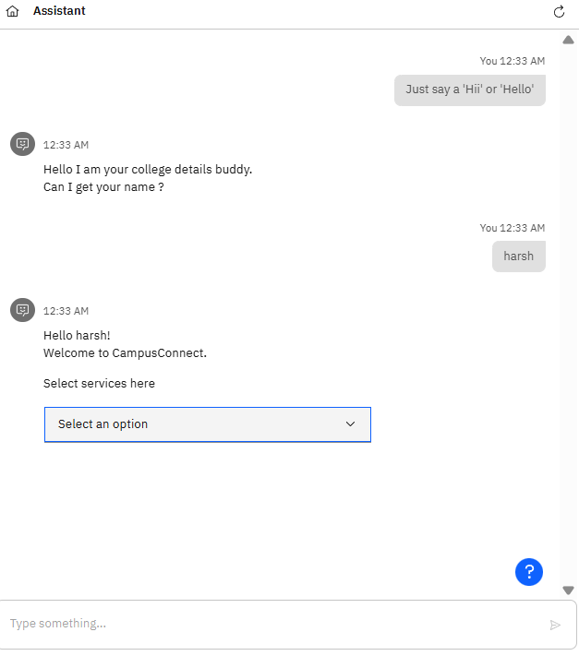
Results

Slide 9
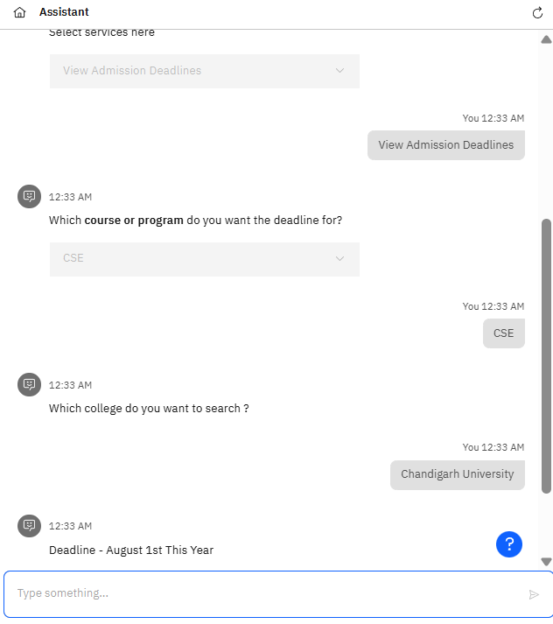
Results

Slide 10
Conclusion
The College Admission Agent successfully automates admission-related queries, providing instant, accurate, and user-friendly responses using RAG and AI-powered conversation.
The system reduces manual workload for admission offices, improves applicant experience, and ensures faster access to critical information like eligibility, fees, and deadlines.
With scalability and future enhancements such as multi-language support, voice interaction, and multi-institution coverage, the agent can evolve into a comprehensive, next-generation admission assistant.

Slide 11
GitHub Link
https://github.com/harshranjan0522/College-Admission-Agent

Slide 12
Future scope
Multi-Language and Voice Support
Integration with Real-Time Portals
Multi-Institution and Regional Expansion
AI Enhancements and Personalization

Slide 13
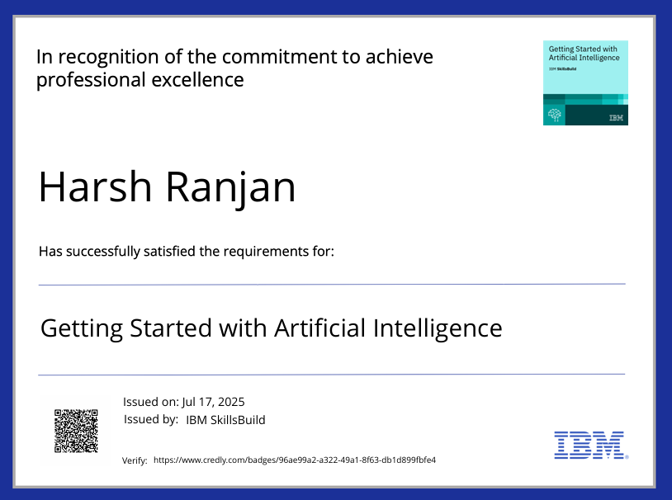
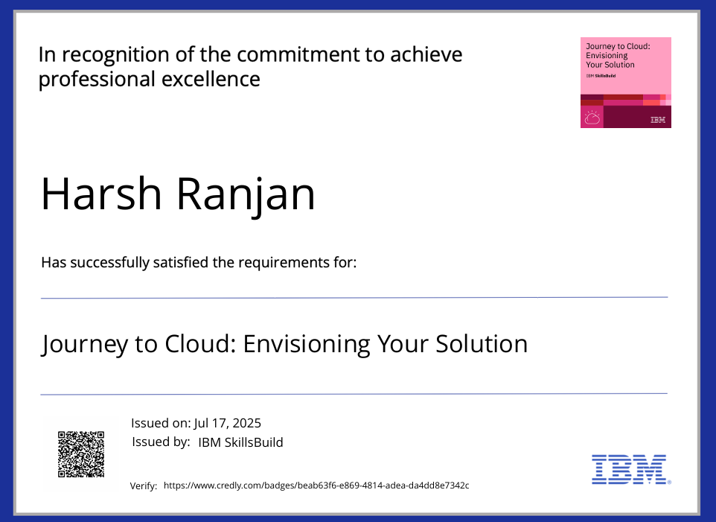
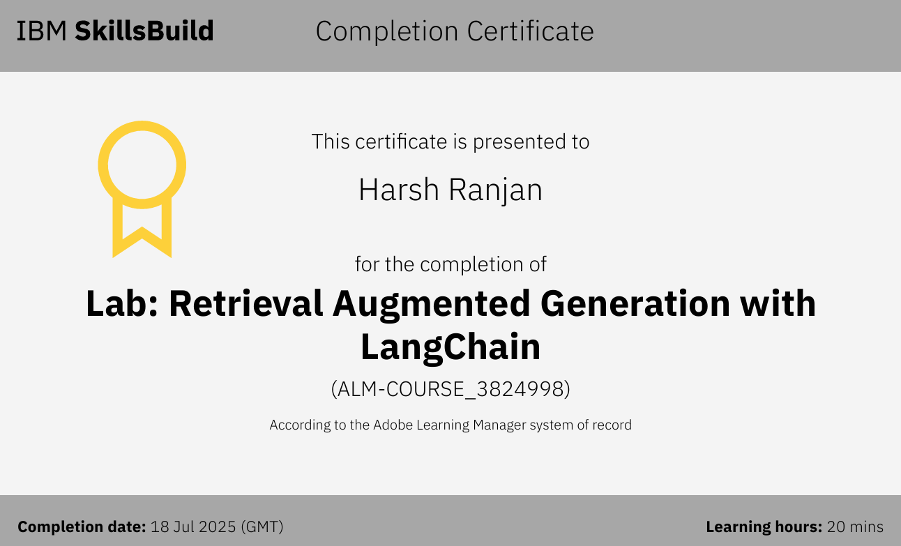
IBM Certifications

Slide 14
THANK YOU

